Slide 1
Data Structures
CSE2253

Slide 2
Module-1
Review of C
Programming Concepts

Slide 3
Introduction to C programming
Overview of C
Basic structure of C program
I/O statements
Conditional Statement
Unconditional Statement
Looping Statements
Switch
1D and 2D arrays
Pointers
Functions
Structures
Unions

Slide 4
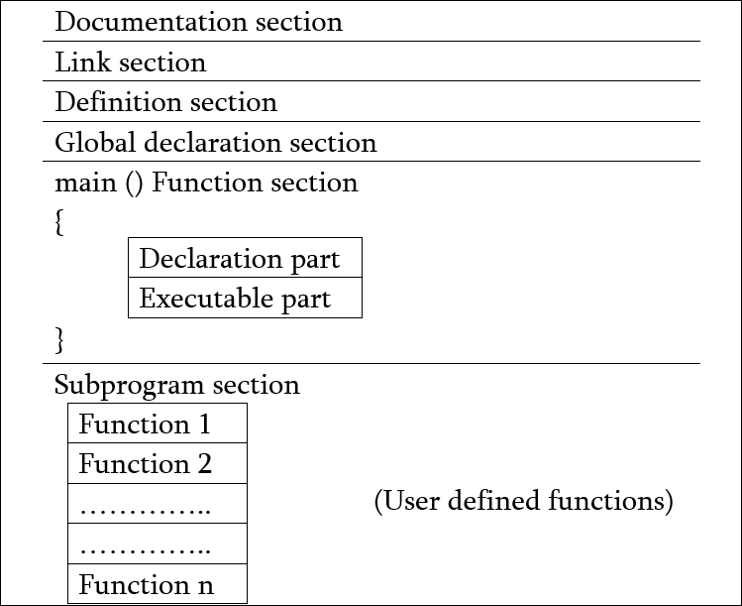
Basic structure of C program

Slide 5
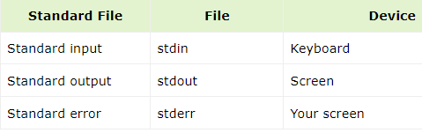
Input/ Output statements
Input operation
Output operation
C language provides libraries (header files) that contain various functions for input and output.
C language treats all the devices as files.
The following three files are automatically opened when a program executes to provide access to the keyboard and screen.

Slide 6
Types of Input and Output Functions
Unformatted character IO functions: getchar() and putchar()
Unformatted string IO functions: gets() and puts()
Formatted IO functions: scanf() and printf()

Slide 7
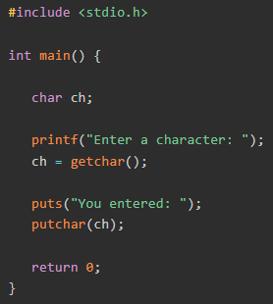
Unformatted character I/O functions
accept a single character as input from the keyboard
display a single character on the output terminal
getchar() function it reads a single key stroke
without the Enter key.
no parameters required
function returns an integer corresponding to the
ASCII value of the character key input by the user.

Slide 8
Formatted String Input & Output Functions
gets( ) function ---- enter some characters followed by the enter key.
All the characters get stored in a character array.
Null character is added to the array to make it a string.
gets( ) allows the user to enter the space-separated strings.
#include<stdio.h>
void main ()
{
char s[30];
printf("Enter the string? ");
gets(s);
printf("You entered %s",s);
}

Slide 9
Puts( ) function
very much similar to printf( ) function.
used to print the string on the console which is previously read by using gets() or scanf() function.
returns an integer value representing the number of characters being printed on the console.
Since, it prints an additional newline character with the string, which moves the cursor to the new line on the console, the integer value returned by puts() will always be equal to the number of characters present in the string plus 1.

Slide 10
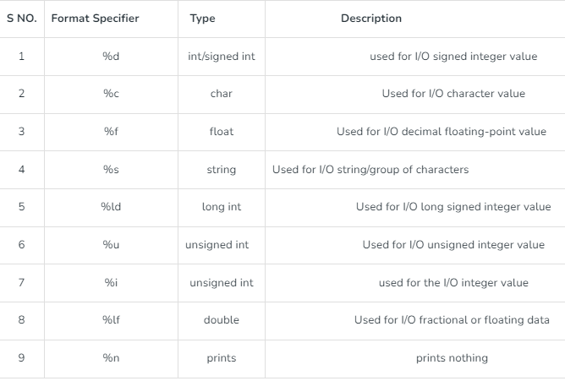
Formatted Input & Output Functions
help to display the output to the user in different formats using the format specifiers.
we can format these functions according to our needs.

Slide 11
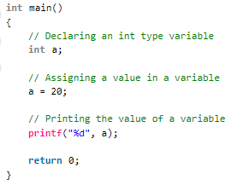
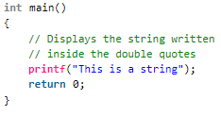
printf( )
to display any value like float, integer, character, string, etc on the console
pre-defined function that is already declared in the stdio.h
printf(“Format Specifier”, var1, var2, …., varn);

Slide 12
scanf( )
reading or taking any value from the keyboard by the user
these values can be of any data type like integer, float, character, string, and many more.
declared in stdio.h
In scanf() function we use & (address-of operator) which is used to store the variable value on the memory location of that variable.
scanf(“Format Specifier”, &var1, &var2, …., &varn);

Slide 13
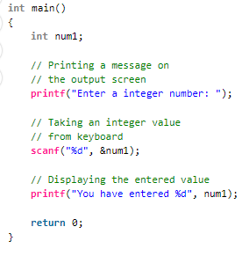
Examples of scanf( )

Slide 14
BRANCHING
Decision Making and Branching:
Simple -if
if-else
If-else-if-else(else-if ladder)
Switch case
Nested-if
Conditional Operator.

Slide 15
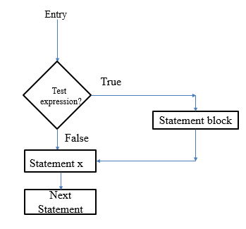
SIMPLE if Statement
The simple if statement has the following syntax:
if (test-expression)
{
statement-block;
}
statement x;

Slide 16
Example
if( age>=18)
{
printf(“ Eligible to vote”);
}

Slide 17
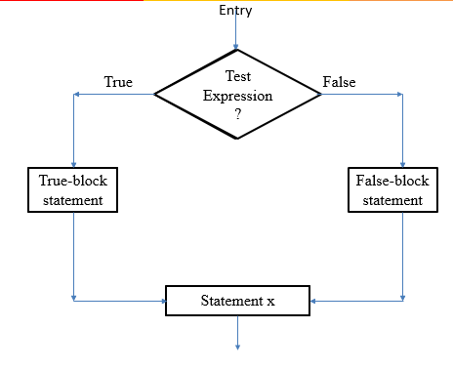
if-else Statement
The if-else statement has the following syntax:
if (test-expression)
{
True-statement-block;
}
else
{
False-statement-block;
}
Statement x;

Slide 18
Example
if ( age>=18)
{
printf(“Eligible to vote”);
}
else
{
printf(“Not eligible to vote”);
}

Slide 19
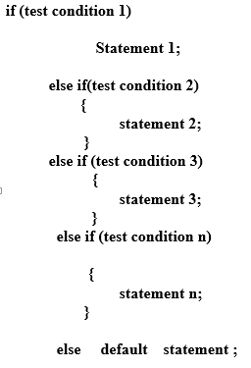
If-else-if-else (ELSE – IF LADDER)

Slide 20
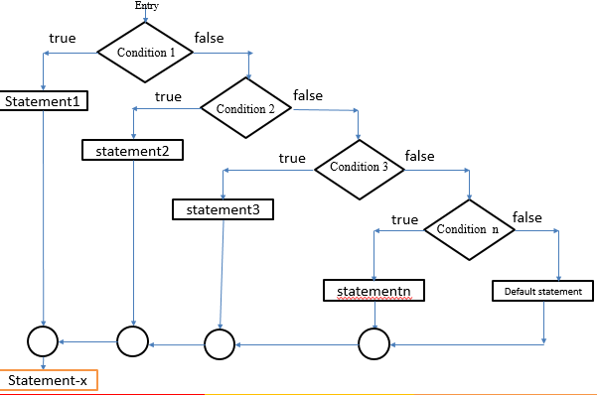
FLOWCHART OF ELSE-IF LADDER

Slide 21
EXAMPLE
if (code==1)
printf(“colour=“red”);
else if( code ==2)
printf(“colour=“yellow”);
else if(code==3)
printf(“colour=“green”);
else
printf(“invalid input”);

Slide 22
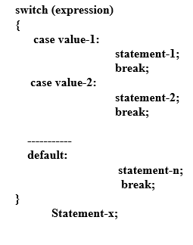
Switch case

Slide 23
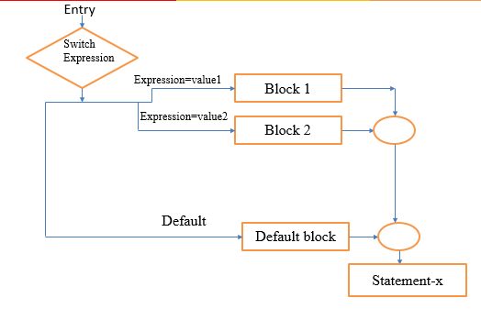
FLOWCHART OF SWITCH –CASE STATEMENT

Slide 24
EXAMPLE
Switch(character)
{
case ‘A’ : printf(“Green”);
break;
case ‘B’: printf(“Yellow”);
break;
case ‘C’: printf(“Red”);
break;
default : printf(“ no choice”);
}

Slide 25
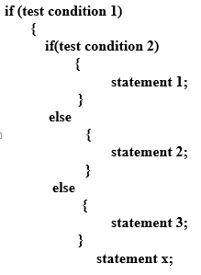
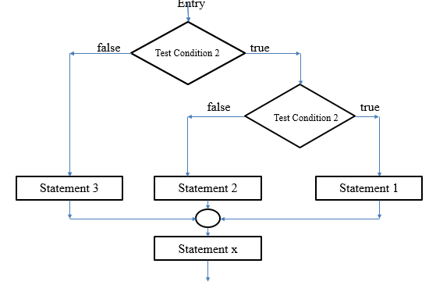
Nested if-else

Slide 26
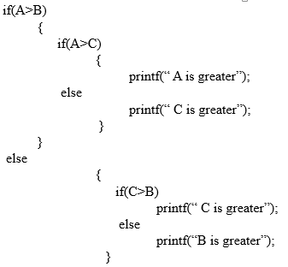
Example

Slide 27
LOOPING
While
Do-While
For
Nested looping statements

Slide 28
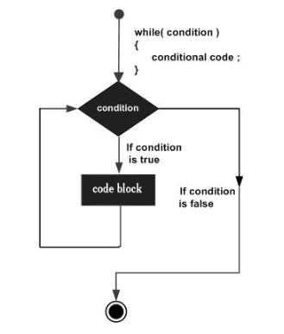
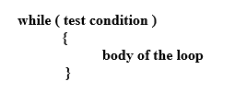
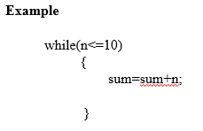
WHILE STATEMENT

Slide 29
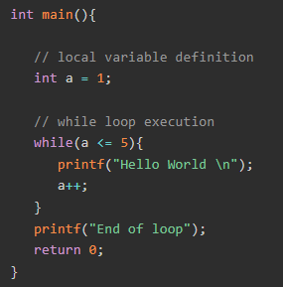
Example

Slide 30
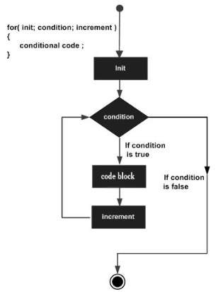
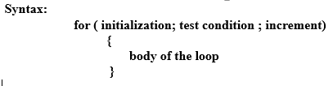
FOR STATEMENT

Slide 31
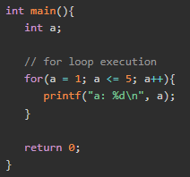
Example

Slide 32
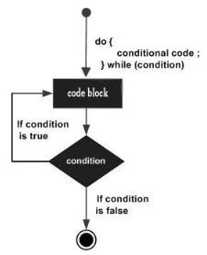

Do while loop

Slide 33
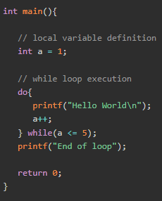
Example

Slide 34
Program to add numbers until user enters zero
#include <stdio.h>
int main()
{
double number, sum = 0; // the body of the loop is executed at least once
Do
{
printf("Enter a number: ");
scanf("%lf", &number); sum += number;
}while(number != 0.0);
printf("Sum = %.2lf",sum);
return 0;
}

Slide 35
Array
Array is the derived data type.
Array is the homogeneous collection of data items.
The elements of an array are of same data type and each item can be accessed using the same name.

Slide 36
Classification of arrays
Single Dimension Array
Two Dimension Array
Single Dimension array: A single-dimensional array is a linear list containing the data items of the same type and stored in continuous memory location.

Slide 37
Single Dimension Array (1D - Array)
Declaration of 1D Array
Syntax:Data_type Array_name[ Array_size];
Data_type –general data types like - int, char, float, double.
Array_name – valid identifier.
Array_size - maximum number of elements.
Example:
1. int arr [20] ;
2. float arr1 [30] ;
3. double arr2 [30] ;

Slide 38
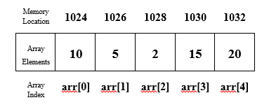
Single Dimension Array (1D - Array)
Pictorial Representation of Single Dimensional array
Representation of an array int arr[5], with five integers array elements and by assuming the memory location starting from 1024

Slide 39
Single Dimension Array (1D - Array)
Initialization of Arrays
(i) Complete array initialization.
(ii) Partial array initialization.
(iii) Initialization without size.
(iv) String initialization.

Slide 40
Single Dimension Array (1D - Array)
(i) Complete array initialization.
In the complete array initialization all the locations of an array is assigned with some value during declaration.
Ex:-int arr[5]={10,15,1,3,20};
(ii) Partial array initialization.
If the number of values to be initialized is less than the size of the array, then the remaining locations will be initialized to zero automatically.
Ex- int a[5]={10,15}; // Remaining Locations are initialized to 0

Slide 41
Single Dimension Array (1D - Array)
(iii) Initialization without size.
→ In initialization without size of an array the size is not specified during the declaration but the values are specified.
→ Consider the declaration along with the initialization.
Ex:-int arr [ ]={10, 15, 1, 3, 20};
(iv) String initialization.
→ Here the string is initialized to the array and the data type will be character only.
→ Consider the declaration with string initialization.
Ex:- char str[ 6 ]=“PINKU";

Slide 42
Single Dimension Array (1D - Array)
Reading Elements to 1D array
If ‘n’ elements have to be stored in an array a[] of int type then
for(i=0;i<n;i++)
scanf(“%d”,&a[i]);
Displaying Elements to 1D array
If ‘n’ elements have to be displayed of an array a[] of int type then
for(i=0;i<n;i++)
printf(“%d\t”,a[i]);

Slide 43
Two Dimension Array (2D - Array)
Declaration of 2D arrays:
Syntax: Data_type Array_name[row_size][column_size];
Data_type –general data types like - int, char, float, double.
Array_name – valid identifier.
row_size- indicates the subscript value for the maximum number of rows.
column_size- indicates the subscript value for the maximum number of columns.

Slide 44
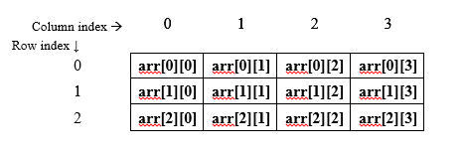
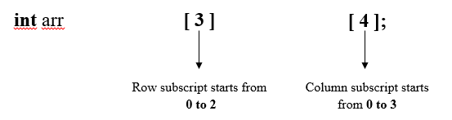
Two Dimension Array (2D - Array)
Pictorial representation of 2D – Array

Slide 45
Two Dimension Array (2D - Array)
Reading of values to 2D array:
In 2D as two subscripts are there each for row and column, we need two for loops to read the element to the 2D array.
Example: int arr[3][2];
for(i=0;i<3;i++)
{
for(j=0;j<2;j++)
{
scanf(“%d”,&a[i][j]);
}
}
Generalised: for(i=0;i<m;i++) // m is no of rows { for(j=0;j<n;j++) // n is no of columns { scanf(“%d”,&a[i][j]); } }

Slide 46
Two Dimension Array (2D - Array)
Displaying of values to 2D array:
In 2D as two subscripts are there each for row and column, we need two for loops to display the element to the 2D array.
Example: int arr[3][2];
for(i=0;i<3;i++)
{
for(j=0;j<2;j++)
{
printf(“%d\t”,a[i][j]);
}
printf(“\n”);
}
Generalised: for(i=0;i<m;i++) // m is no of rows { for(j=0;j<n;j++) // n is no of columns { printf(“%d\t”,a[i][j]); } printf(“\n”); }

Slide 47
User Defined Functions
block of code that performs a specific task
Function prototype
Function call
Function definition

Slide 48
Function Prototype
declaration of a function that specifies function's name, parameters and return type
Syntax

Slide 49
Calling a function
Control of the program is transferred to the user-defined function by calling it
Syntax

Slide 50

Function definition
contains the block of code to perform a specific task

Slide 51
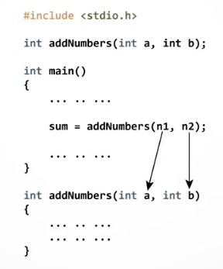
Passing arguments to a function
Actual parameter/argument
Formal parameter/argument

Slide 52
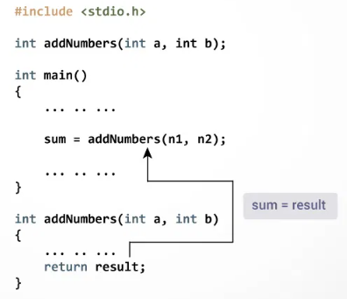
Return Statement
return statement terminates the execution of a function and returns a value to the calling function

Slide 53
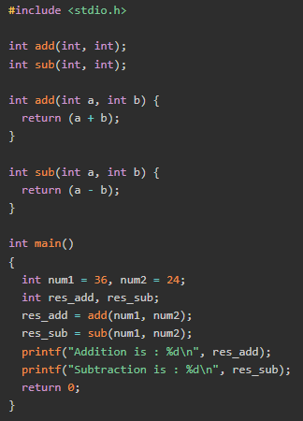

Slide 54
user-defined Datatype in C
data types defined by the user
It enables customization in the code
Users can write more efficient and flexible code
Provides abstraction.
There are 4 types of user-defined data types in C
Structure
Union
Enum
Typedef

Slide 55
structure
used to group items of different types into a single type.
The “struct” keyword is used to define a structure.
The size of the structure is equal to or greater than the total size of all of its members.

Slide 56
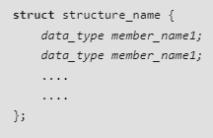
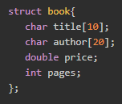
Declaring a structure

Slide 57
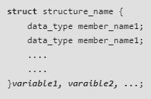
Structure Variable Declaration

Slide 58
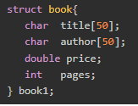
Structure variable declaration examples

Slide 59
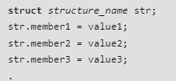
Structure Initialization

Slide 60
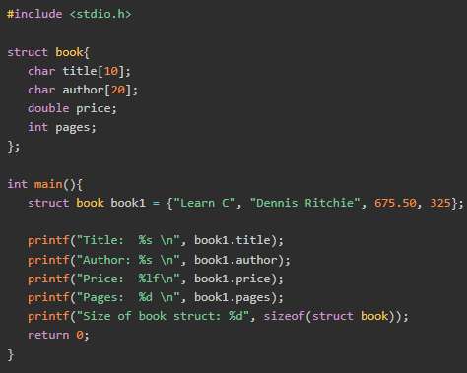
Accessing the Structure Members
first, declare a structure variable and then use the dot (.) operator along with the structure variable.

Slide 61
Union
to store different data types in the same memory location
Unions provide an efficient way of using the same memory location for multiple purpose.
One can define a union with many members, but only one member can contain a value at any given time.
All the members of a union share the same memory location.
The largest union member defines the size of the union.

Slide 62
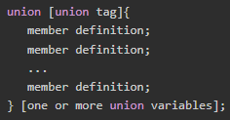
Defining a Union
Union variables are created in same manner as structure variables
keyword union is used to define unions
member access operator (.)

Slide 63
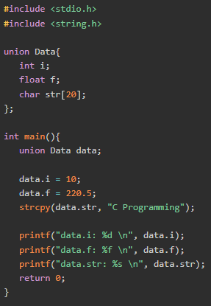

Slide 64

Pointers
Address Variable

Slide 65

Pointer initialization

Slide 66
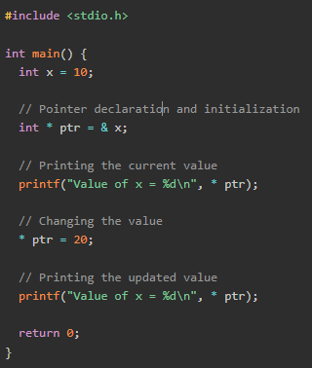
Access and Manipulate Values using Pointer

Slide 67
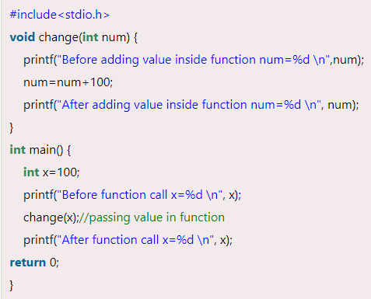
Call by value

Slide 68
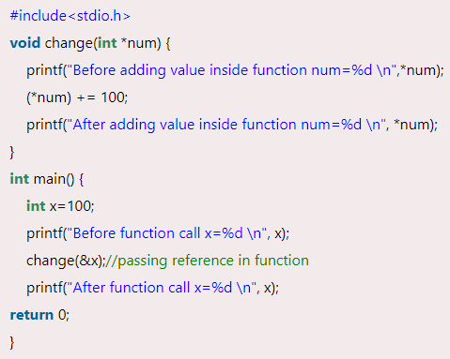
Call by reference

Slide 69
Data Structure
“Data Structure is a way of organizing and storing data in a computer so that it can be accessed and modified efficiently.”
A data structure is a specialized format for organizing, processing, retrieving, and storing data, often designed to allow efficient operations such as insertion, deletion, traversal, and searching.
A data structure is a specialized format for organizing, processing, retrieving, and storing data, often designed to allow efficient operations such as insertion, deletion, traversal, and searching.

Slide 70
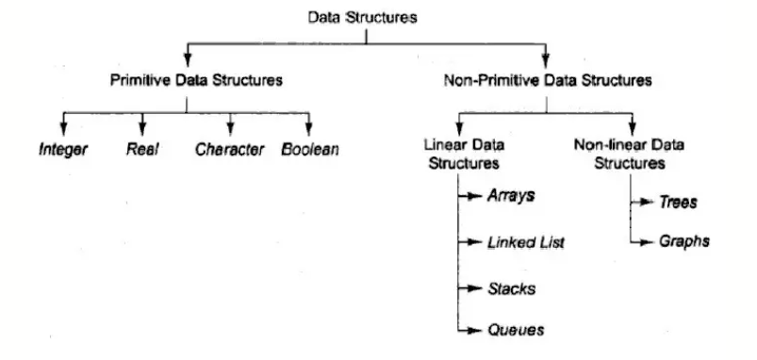

Slide 71
Primitive Data Structures
These are the structures which are supported at the machine level, they can be used to make non-primitive data structures.
These are integral and are pure in form.
They have predefined behavior and specifications.
Examples: Integer, float, character etc

Slide 72
Non-Primitive Data Structures
The non-primitive data structures cannot be performed without the primitive data structures.
Although, they too are provided by the system itself yet they are derived data structures and cannot be formed without using the primitive data structures.
The Non-primitive data structures are further divided into the following categories: Linear and Non-Linear Data Structures

Slide 73
Linear Data Structure
A linear data structure traverses the data elements sequentially, in which onlyone data element can directly be reached.
Ex: Arrays, stack, queues, Linked Lists, etc

Slide 74
Non-Linear Data Structure
Every data item is attached to several other data items in a way that is specific for reflecting relationships.
The data items are not arranged in a sequential structure.
Ex: Trees, Graphs

Slide 75
Why data structures are important?
Efficient memory usage
Faster processing and retrieval
Basis for algorithms and problem-solving
Essential for software development, database systems,
operating systems, and machine learning

